Slide 1
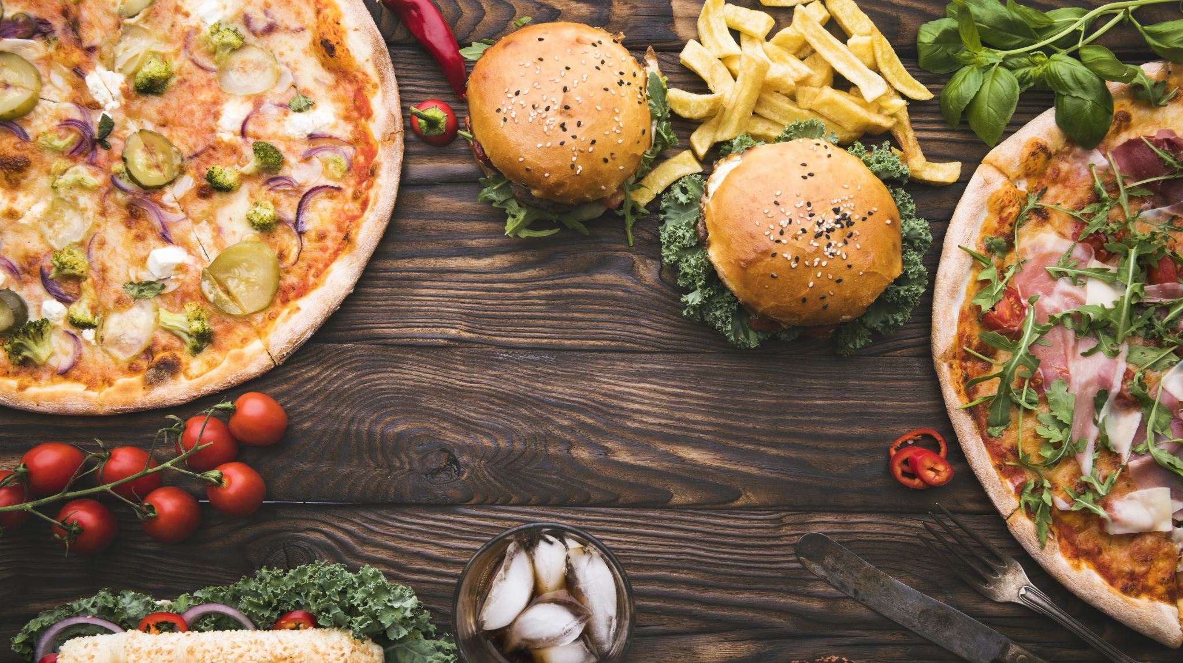
Project 1: OLAP Restaurant Services Database

Slide 2




Project 1 At a Glance:
NY Open Restaurant Applications (4.4MB) (14.5K Rows)
NY Open Restaurant Inspections (14.5MB) (79.2K Rows)
Project Management:
NY Food & Safety Inspections (90.4MB) (209.7K Rows)
NY YellowPages Restaurant Listings (1MB) (3K Rows)
Documentation:
EXTRACT
TRANSFORM
LOAD
Remove Duplicates
Deal with NULLs
Unify Column Naming Schemes
Create Keys
Discard Unneeded Columns
Create New Columns
Levenshtein Distance
Other
YellowPages.csv
(Scraped)
E.D.A. &
Viz.
Data
Modeling
Load into
PostgreSQL
Data.gov CSVs
(Open Data)

Slide 3
Questions and Challenges
What is the goal? Who are the Data Consumers?
Answering these questions will decide which Tables are going to be the source of our primary information and which Tables will be joined with supplementary information. This will also give us a direction on what Data should be kept, what new features we should introduce, and what Data may be discarded.
Scenario A: We are working with YellowPages to add new features to their mobile app, which lets users see if a restaurant is approved for the NY Open Restaurant initiative, and the restaurant’s Food & Safety Inspection results, if available.
The Data from the scraped YellowPages website is our primary data. We match the Inspection and Open Restaurant Tables with the Restaurants in the YellowPages table, and discard information for restaurants that are not in our list of Scraped information. However, our list of Scraped restaurants is limited to the top 100 results of restaurants in New York on YellowPages.
Scenario B: We are working for a market research firm, and the goal of our Analysts is to answer the following question: Do Restaurants that pass the NY Open Restaurant Policy and Food & Safety Inspections get higher review scores and better search result placements on YellowPages than those who do not?
In this scenario, we cannot discard the Inspection and Open Restaurant data, as that data is the bedrock of our analysis. Our analysts will match the YellowPages data to this data during their analysis.

Slide 4
Questions and Challenges
The scraped YellowPages Data is not exhaustive.
When searching for Restaurants in New York on YellowPages, we get about 3000 results. However, this does not mean there are only 3000 restaurants listed on YellowPages. When the same script is run multiple times, the resulting data starts to differ after the 2000 row mark. After running the script multiple times, I find that 8% of the resulting restaurants differ among the different datasets.
This could be because YellowPages’ search algorithm indexes search results based on relevance, traffic, ratings and a bunch of other factors. As we go down the list of results, the algorithm has fewer metrics to score restaurants by, and for the last few hundred results, it returns a random selection of restaurants that have the same score, from a potential pool of thousands of low-scoring restaurants.
Engineers working for YellowPages would have access to the complete Data, but there are ways we can make our data more representative of the actual list of restaurants in New York. By splitting our search by different tags, neighborhoods, or cuisines, we could get a more in-depth list of restaurants.
For example: We may only have about 200 Indian Restaurants in the top 3000 results on YellowPages, but by searching for Indian Restaurants in New York, we could get over 500 results of Indian Restaurants alone. By making multiple granular searches, creating dozens if not hundreds of smaller datasets, and by combining and removing duplicates from resulting datasets, we could get a larger list of restaurants that would make our final Database better prepped for analysis.
However, perfect is the enemy of good, and for this project, a smaller set of data may suffice.

Slide 5
Key/ID | Restaurant Name | Street Address | GlobalID
XYZ123 | McD | 1 Street
XYZ124 | Saucepan | 1 Street
XYZ123 | McD | 1 Street
XYZ126 | Goodeats | 2 Street
XYZ127 | Chinese Hut | 3 Street
XYZ128 | Pizza Heaven | 2 Street
XYZ123 | McD | 1 Street
Key/ID | Restaurant Name | Street Address | GlobalID
XYZ123 | McD | 1 Street | 1
XYZ124 | Saucepan | 1 Street | 2
XYZ123 | McD | 1 Street | 1
XYZ126 | Goodeats | 2 Street | 3
XYZ127 | Chinese Hut | 3 Street | 4
XYZ128 | Pizza Heaven | 2 Street | 5
XYZ123 | McD | 1 Street | 1

